Slide 1
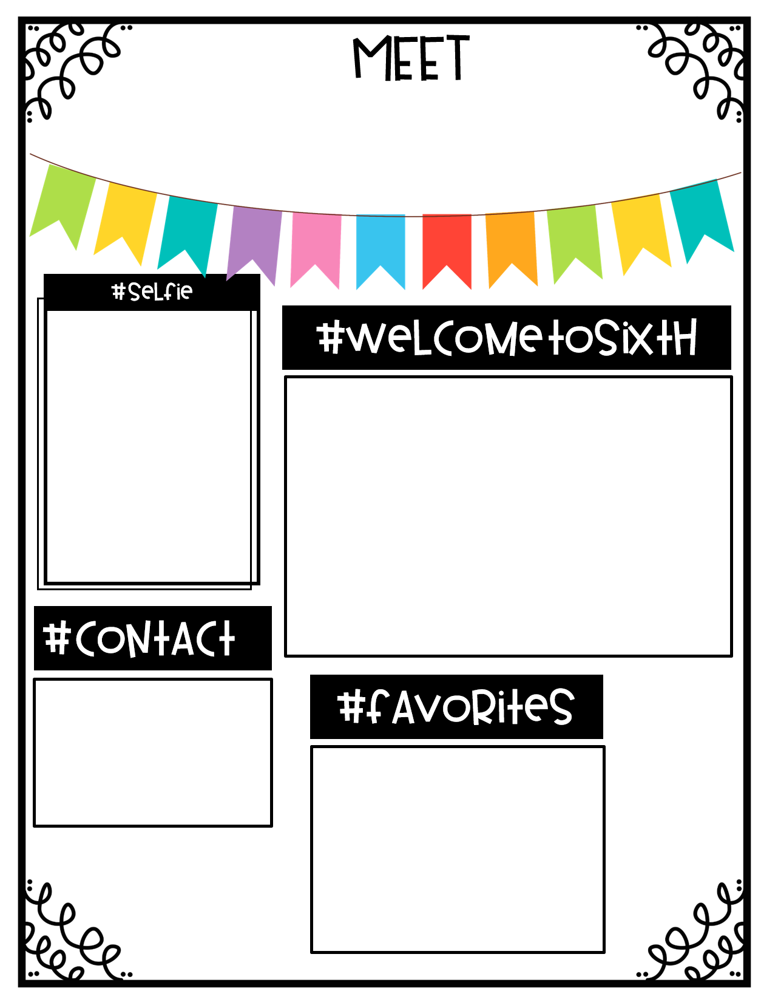
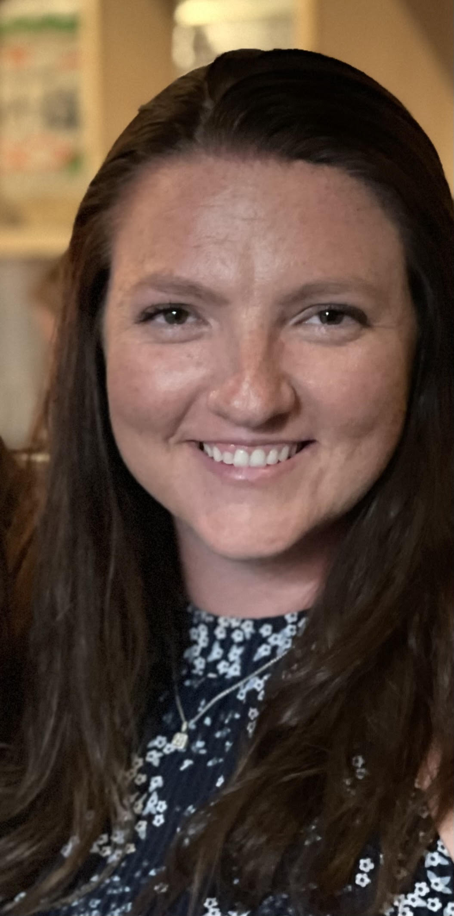
Ms. O’Neill
Welcome Sixth Graders and Parents! My name is Ms. O’Neill and I am excited to be your teacher this year. I will be working with Mr. Floyd and Mrs. Davies teaching 6th Grade Math. I am excited to see some familiar faces from 5th Grade and make some new memories this year.
Email:
koneill@barnegatschools.com
Phone:
(609) 660-7500
Starbucks
Dunkin
Wawa
Working out
Going to the beach
Color: Pink

